Slide 1


R
OMANIA
Notes:
Welcome everybody
Introduce GFG
Staff members introduce themselves

Slide 2


Course Overview
Steel Plant STEM kit and retrofit build
GFG jobs: application process and mock interviews
Qualifications: Digital CV Writing and Interview Skills
Exhibition
Notes:
Click through the 4 points
Steel plant - build a model steel plant, similar to the blast furnace last year, but on a bigger scale
Jobs - learn about jobs within GFG and go through a mock application process
Qualification - gain qualifications in digital cv writing and interview skills
Exhibition - showcase your work on Friday

Slide 3

Course Outcomes
1. Learners to gain knowledge about GFG careers
2. Learners to gain knowledge around the current and future steel plants
3. Learners gain knowledge around digital skills and job applications
4. Learners develop their soft skills, especially team work, communication and problem-solving
5. Learners develop their STEM (science, technology, engineering and maths) skills
Notes:
Click through and read out the 5 course aims from the screen

Slide 4
Day 1
Course introduction, ice-breaker & registration
Introduction to STEM skills, digital skills, CV writing & interview skills
Stage 1 - current vs future (steel plant)
Stage 2 - STEM activity: steel plant build
Recap
Day 2
Introduction: electricity generation, current vs future
Stage 3 - STEM activity: renewable electricity
Stage 4 - STEM activity: retrofit
Recap
Day 3
Introduction: CV Writing & Digital Skills
CV writing
Recap
Day 4
Introduction: Interview skills
Interviews and rotation activities
Interview reflections
Recap
Day 5
Introduction and finalisation
Exhibition preparation & feedback
Exhibition & celebration
Weekly
Timetable
Notes:
Give participants a weekly overview

Slide 5
Day 1 Timetable
Day 1
Course introduction, ice-breaker & registration
Introduction to STEM skills, digital skills, CV writing & interview skills
Stage 1 - current vs future (steel plant)
Stage 2 - STEM activity: steel plant build
Recap
Notes:
Read out the overview for the day.

Slide 6

Safety
Finger traps
Minor cuts
Flashing lights (epilepsy)
Slips, trips and falls
Emergency exits
Notes:
Click through and read out the safety information

Slide 7

Ice Breaker
Name
Interesting Fact
Dream Job
Notes:
Staff to begin by introducing themselves and starting the ice breaker before asking the participants.
*Use microphone

Slide 8


Social Contract
Course rules
Sign and display
Notes:
Ask participants to help come up with the rules for the course. Suggestions include:
Respect, no bad language, listening, teamwork, encouragement, etc…
Ask all participants and staff to sign the rules and then display them in the room.

Slide 9
STEM Skills
What does STEM stand for?
Notes:
Ask participants if they remember what STEM stands for revealing the answer below
Science
Technology
Engineering
Mathematics

Slide 10
Digital Skills
Has anyone heard of digital skills?
What might digital skills cover?
What digital skills do you have? What technology/ software do you use?
Definition: Is the ability to find, evaluate, use, share, and create content using digital devices, such as computers and smartphones.
Notes:
Engage in an open-discussion with participants for each question before discussing the answers below
Digital Skills: The use of digital software and hardware. Example include, creating a CV, email, calendars, music software, powerpoint presentations and many more.
What it covers: Digital skills are used in the vast majority of today’s job roles. This can be from simply using email and digital calendars, to the more advance, such as product design and even space exploration.

Slide 11
CV Writing
What is a CV?
Does anyone have a CV?
What do you need to include on a CV?
Definition: A CV is a document used when applying for jobs. It should include a personal statement, relevant qualifications and work-experience. As well as skills, hobbies, volunteering and references
Notes:
Engage in an open-discussion with participants for each question before discussing the answers below:
Include on a CV: Contact information, personal statement, qualifications and job history, skills
and hobbies, and references.
Click to reveal definition

Slide 12
Interview Skills
What skills do you think are needed for a CV?
How would you prepare for an interview?
Definition: The emotional and tactical techniques that job-seekers more effective when interviewing for a new job.
Notes:
Engage in an open-discussion with participants for each question before discussing the answers below:
Skills include, confidence, preparedness, punctuality, attention to detail,
etc…
Click for definition

Slide 13
Qualifications
Digital CV Writing
Interview Skills
Notes:
Showcase the qualifications.
Ask the participants if they have any questions
CV Writing: Level 1 and 1 credit
Interview skills: Level 1 and 3 credits

Slide 14
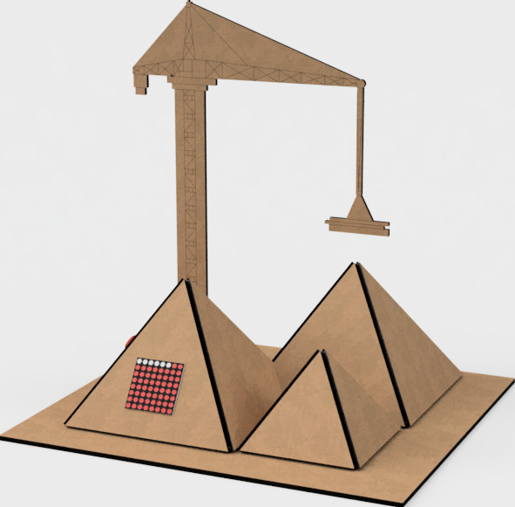
Stage 1:
What makes a Steel Plant
The different sectors of a steel plant
What each sector does
What jobs each sector has
Notes:
*Hand out workbooks 1/person
Engage in a open-discussion with participants for each question
Sectors: Raw Material, Blast Furnace, Steel Shop, Rolling/Finishing, and Support
Provide a definition for each sector
Jobs per sector: Raw Materials
Electrical Engineer, Electrician, Metallurgical Engineer, Pile-up Preparatory
Blast furnace
Electrical Engineer, Electrician, Furnace Worker, Planning Engineer
Finishing
Automation Engineer, Electrician, Pickle Worker, Process Engineer
Steel Shop
Electrical Engineer, Electrician, Caster Preparatory, Steel Worker
Support
Accountant, Auditor, Buyer, H&S specialist, Human Resources Inspector
Ask participants if they have any questions about any of the listed jobs

Slide 15
Steel Plant of
the Future
Changes to sectors
Electric Arc Furnace
Benefits of change
Notes:
Engage in a open-discussion with participants for each question before revealing the answer
Changes to sectors: Electric arc furnaces supplement blast furnaces and gets powered by
renewables
Electric Arc Furnace: Use recycled steel and are powered by renewable electricity.
Benefits of change: The changes create a positive environmental change, which also develops worker’s green skills.
Ask participants if they have any questions

Slide 16

Update
Notes:
Play the video.
Encourage participants to pay attention as the video provides answers to the upcoming game

Slide 17


GFG Careers
Card Game
Notes:
*Hand out GFG Careers Card Game
Game:
Each job title card (green or orange) has to be paired with a grey card, which either has a job responsibility or required qualification
Electrical Engineer = Improves the skills level of the electrical maintenance team. Electrician = Maintains all rooms with electrical equipment. Furnace Worker = Supervises the discharge of pig iron and slag. Planning Engineer = Estimates costs, analyses risks and uses maintenance standards. Automation Engineer = Software development to improve the automation. Pickle Worker = Feeds the pickling line based on the manufacturing schedule. Process Engineer = Manufacturing process activities to increase productivity and reduce costs. Steel Worker = Converter handling for steel, slag, temperature sampling. Casting Preparatory = Performs machine control between casting sequences. Metallurgical Engineer = University studies in Metallurgy - Materials, Science and Engineering. Pile-Up Preparatory = Knows the quality characteristics of raw materials. Accountant = University degree in economics (accounting). Auditor = Develops procedures, internal audit methodology according to international standards. Buyer = Develops requests for quotations to selected suppliers. Health and Safety Specialist = Investigating accidents. Human Resources Inspector = Manages the personal files of active employees, insuring all necessary documents concerning, employment, suspension, termination of individual employment contracts, disciplinary sanctions.

Slide 18

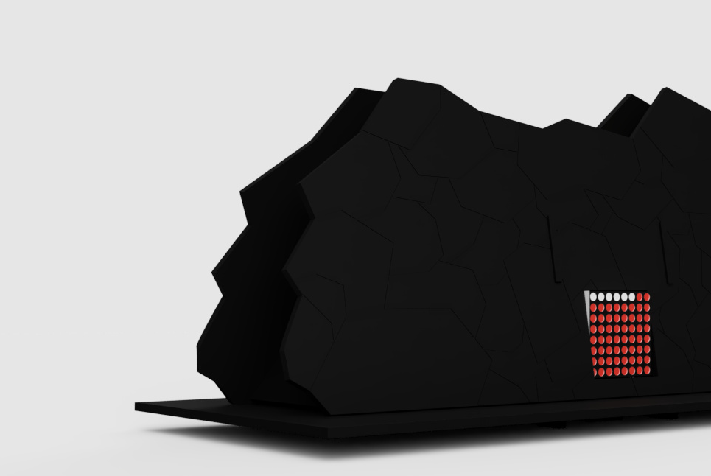
Stage 2: STEM Activity
Delegate roles
1 Sector per person
Notes:
*Handout STEM kit 1/team
*Hand out instructions, 1 for each sector
Workbook page x
Sectors to be built: Raw materials
Blast furnace
Steel shop
Continuous casting
Rolling/finishing
Power plant
Teams agree who is going to build what sector.
Encourage participants who finish first to help their teammates

Slide 19
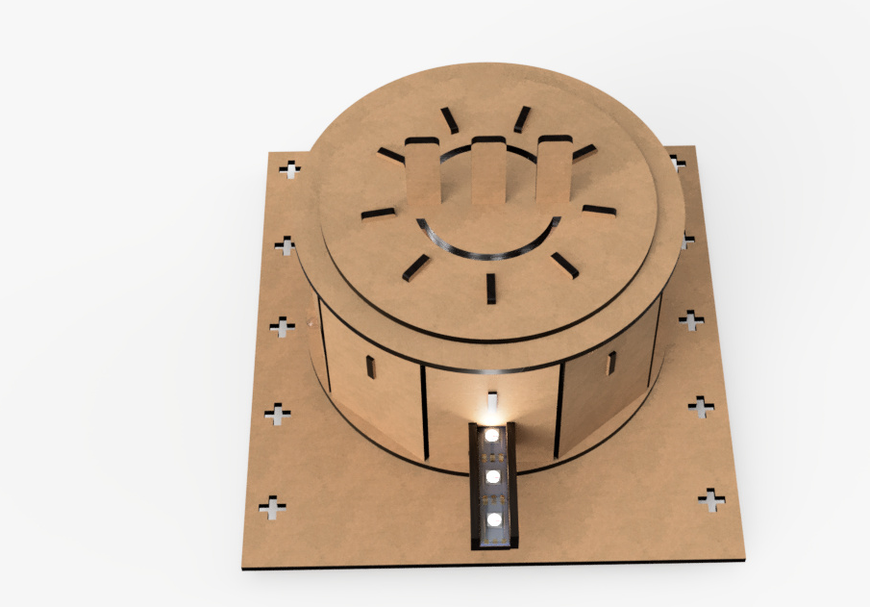
Troubleshooting
Notes:
Ask students to test their circuits.
Rewise staff will assist

Slide 20
Day 1 Recap
Any questions
Skills used: problem solving, team working, perseverance, etc…
Recap: green skills, digital skills, CV writing and interview skills
Well done!

Slide 21
Day 2 Timetable
Day 2
Introduction: electricity generation, current vs future
Stage 3 - STEM activity: renewable electricity
Stage 4 - STEM activity: retrofit
Recap
Notes:
Read out the overview for the day.
The video on the next slide is how a steel plant is powered current vs future.

Slide 22
Update
Notes:
Play the video.
Encourage participants to pay attention as the video provides answers to the upcoming game

Slide 23


Current vs Future Card Game
Notes:
*Hand out a card game pack to each team.
Participants must work as a team to discuss which cards relate to either the ‘current’ or the ‘future’ topic card and list them underneath.
Answers
Current: fossil fuels, blast furnace, finite resources, produces C02, traditional jobs & sectors, contributes to global warming
Future: development of green skills & jobs, wind turbines, solar farms, electric arc furnace, reduced emissions, green energy, recycled steel, sustainability

Slide 24
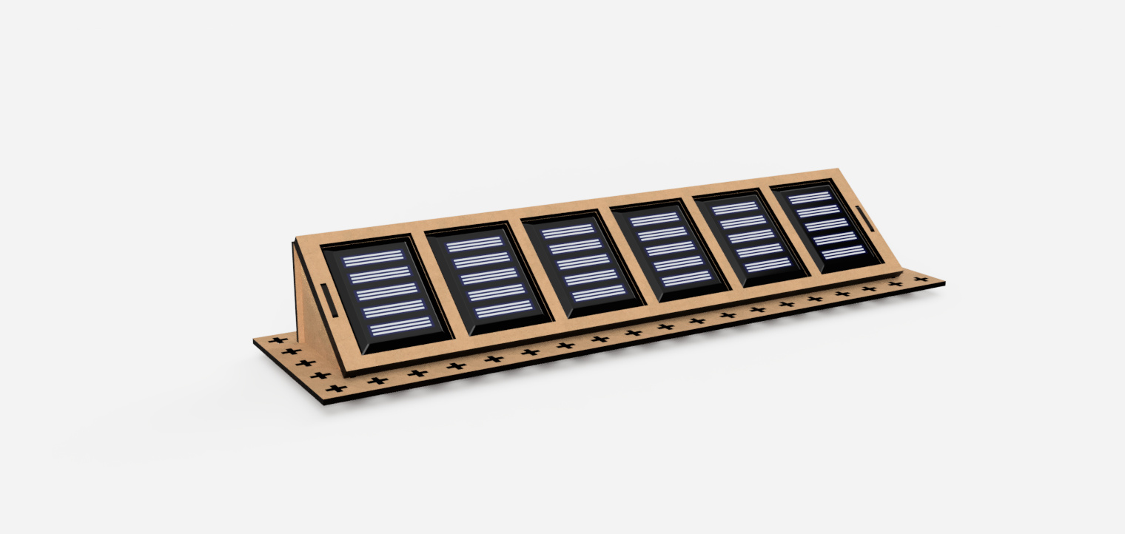
Stage 3:
Renewable Electricity
Wind Turbines
Solar Farm
Notes:
*Hand out wind turbine kits and a solar farm kit to the teams.
Now that participants have learned about what will power the steel plants of the future, their task is to build wind turbines and solar farms to power their STEM kit. Teams to delegate who is going to build what. Each team is tasked to build:
2 people to build 1 solar farm. Instruction step X-X
3-4 wind turbines (depending on the team size) - 1/person Instruction step X-X
Once the wind turbines have been build, teams must wire the wind turbines together and add them to the base. Instruction step X-X

Slide 25
Solar Farm Experiments
Torch
Multimeter
Notes:
*Hand out a torch, hairdryer, multimeter and crocodile cables
Test the solar farm, by connecting it to the multimeter and shinning the torch at the solar panels to produce electricity
Teams experiment by shading the panels and also testing different torch angles to see how many volts they can generate.
Can be fun to make this activity competitive by challenging the teams to see who can produce the most amount of volts.

Slide 26
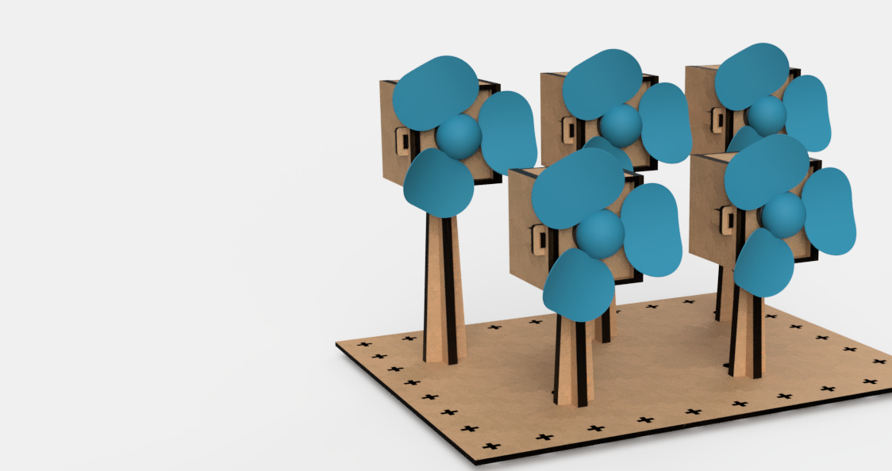
Wind Farm Experiments
Hairdryer
Multimeter
Notes:
Test one turbine, by connecting it to the multimeter and using the hair dryer to spin the blades
Swap the turbines blades to the other options to see which set of blades is the most effective at producing electricity. There are 4 different sets of blades to test in total
Connect multiple wind turbines together and retest to see how many volts can be generated as a farm.
Can be fun to make this activity competitive by challenging the teams to see who can produce the most amount of volts.

Slide 27
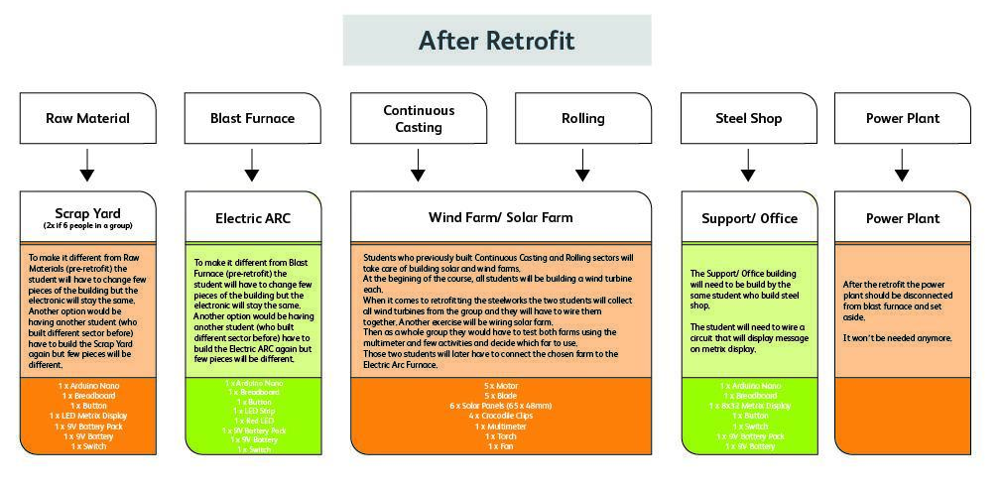
Stage 4: Retrofit
Convert the current sectors to the future sectors
Notes:
*Hand out retrofit kits 1/team
Explain to teams that their challenge now is retrofit the sectors they built into the sectors of the future.
Teams delegate who is going to build what within their team.
Sectors:
Raw materials becomes Scrap yard
Blast furnace becomes Electric arc furnace
Steel shop becomes Support/Office

Slide 28
Day 2 Recap
Any questions
Skills used: problem solving, team working, perseverance, etc…
Recap: what powers the current and future steel plants
Well done!

Slide 29
Day 3 Timetable
Day 3
Introduction: CV Writing & Digital Skills
CV writing
Recap
Notes:
Read out the overview for the day.

Slide 30
Digital CV Writing and Interview Skills Qualification
CV Writing
Definition: A CV is a document used when applying for jobs. It should include a personal statement, relevant qualifications and work-experience. As well as, skills, hobbies, volunteering and references
Digital Skills
Definition: Is the ability to find, evaluate, use, share, and create content using digital devices, such as computers and smartphones.
Notes:
Recap of day 1’s introduction to cv writing and interview definitions
Engage in a open-discussion with participants for each question (orange) before revealing the answer (green) and then the definition
Ask participants if they have any questions

Slide 31
1.1 What are the core elements of a CV?
What do you think should be included in a CV?
Notes:
Engage in a open-discussion with participants for each question, answers blow:
Contact information
Personal statement
Qualification and employment history
Hobbies and interests
References
Ask participants if they have any questions

Slide 32
The importance of digital skills
Why are digital skills important?
Notes:
Engage in a open-discussion with participants for each question, answers blow:
Improves confidence with technology
Most jobs require some form of digital skills
Develops the ability to learn new technologies quicker
Ask participants if they have any questions

Slide 33
What jobs in the steelworks are for me?
Raw Materials
Blast furnace
Finishing
Steel Shop
Support
Notes:
Recap the jobs in each sector
Raw Materials: Electrical Engineer, Electrician, Metallurgical Engineer, Pile-up Preparatory
Blast Furnace: Electrical Engineer, Electrician, Furnace Worker, Planning Engineer
Finishing: Automation Engineer, Electrician, Pickle Worker, Process Engineer
Steel Shop: Electrical Engineer, Electrician, Caster Preparatory, Steel Worker
Support: Accountant, Auditor, Buyer, H&S specialist, Human Resources Inspector

Slide 34
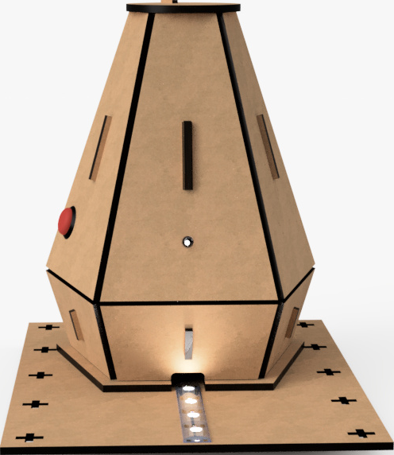
  QR Codes
Scan the QR code!
Notes:
Participants to consider the sector and job that would best suit their skillset and/or most interests them. Allow time for participants to decide.
Once participants are ready they can scan the relevant QR code (found on the different sectors of the STEM kit) to find out more information about the job role on the HUB.

Slide 35
2.1 Identify a job that suits own skills, qualities and goals.
1.1 Identify an opportunity that they would like to be interviewed for
Write your selected job title in full sentences.
Notes:
Workbook page 6.
Note that the following answer provided by the participants answers both 2.1 from the Digital CV Writing qualification and 1.1 from the Interview Skills qualification.
Qualification: Participants to their selected job title, in their own words and using full sentences.

Slide 36
  2.2 Applying for a job
Apply on the Hub
Notes:
Workbook page 6.
Task participants with applying for the job they showed interest in. They can do this by selecting the ‘apply’ button on the Hub (followed on from scanning the QR code earlier).
Qualification: Participants will receive an automated response “Thanks for applying, please can you send us your CV for the position.” This provides evidence that each participant has appleid for a job.

Slide 37
  1.2: Produce a personal CV in a digital format
CV sections
Notes:
*Hand out laptops/tablets 1/person
Participants are tasked with creating a CV using Mirosoft Word. Making it the CV relevant to the job that they have applied for. Participants can use a template to start their CV.
Guide:
Personal Information
Name
Email
Address
Personal statement:
‘About me’
Background and interests
Qualifications and Employment History:
Relevant qualifications
Employment
Volunteering
Interests and Hobbies
Consider use of language: clear and professional, no slang
Only include relevant information, think about your skills that are best suited to the job
Qualification: Participant’s created CVs serves as evidence for to answer 1.2.

Slide 38
Day 3 Recap
Any questions
Skills used: problem solving, team working, perseverance, etc…
Recap: CV writing
Well done!

Slide 39
Day 4 Timetable
Day 4
Introduction: Interview skills
Interviews and rotation activities
Interview reflections
Recap
Notes:
Read out the overview for the day.

Slide 40
What is an Interview?
What is an interview and why are they used?
What common questions are often asked in an interview?
Definition: The emotional and tactical techniques that job-seekers more effective when interviewing for a new job.
Notes:
Engage in a open-discussion with participants for each question, answers below:
What is an interview: Skills include, confidence, preparedness, punctuality, attention to detail,
etc…
What are common questions: why are you interested in this position? What skills can you bring? What projects have you worked on that relate to this job? Etc…
Show definition
Ask participants if they have any questions

Slide 41
Interview Preparation
Why do you think it is important to prepare for an interview?
What and how would you prepare?
What are the key skills that you think will help for an interview?
Notes:
Engage in a open-discussion with participants for each question, answers below:
Prepare for an interview: Builds confidence and prepares you for possible questions
What and how to prepare: Research the employer, consider your relevant skills, prepare outfit, map the route, etc…
Key skills: Confidence, research, communication, body language, etc…
Ask participants if they have any questions

Slide 42
  1.2: Plan steps towards an interview
What would be an appropriate interview outfit?
Questions that the interview might ask and appropriate answers
Relevant experience/information that it would be useful to communicate to the interviewer.
First impressions, confidence, etc…
Notes:
Workbook page 6.
Engage in an open-discussion, asking the participants about the following:
*Possibly use the microphone and pass it around for participants to reply*
What would be an appropriate interview outfit?
Questions that the interview might ask and appropriate answers
Relevant experience/information that it would be useful to communicate to the interviewer.
First impressions, confidence, etc…
Task participants with answering this question within their workbook
Qualification: Participant’s written answer will provide evidence for this section.

Slide 43
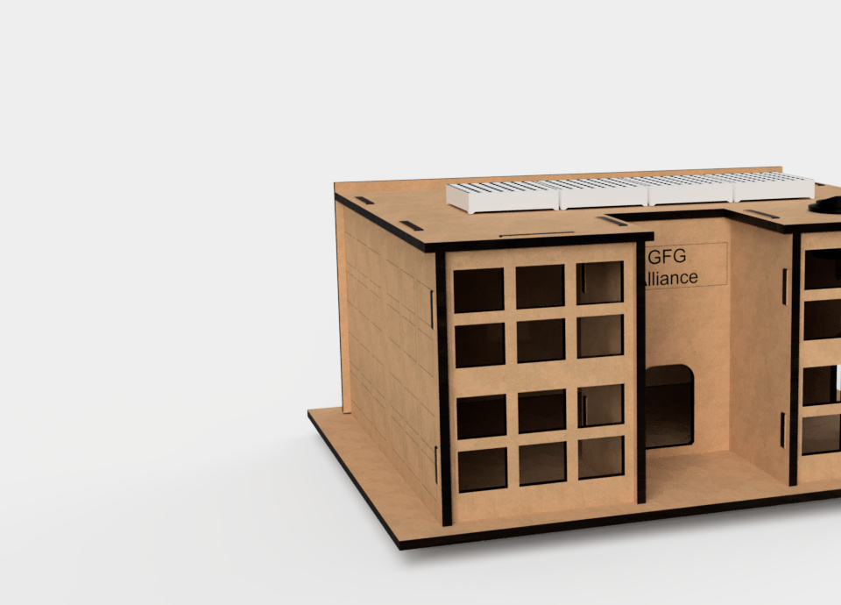
  Plan steps towards an interview
Plan for your interview!
Time slots
Notes:
Workbook page 6.
Participants use their workbook to plan for their interviews.
Research GFG
Research the job role
Staff to give participants their time slots for their mock interviews.

Slide 44
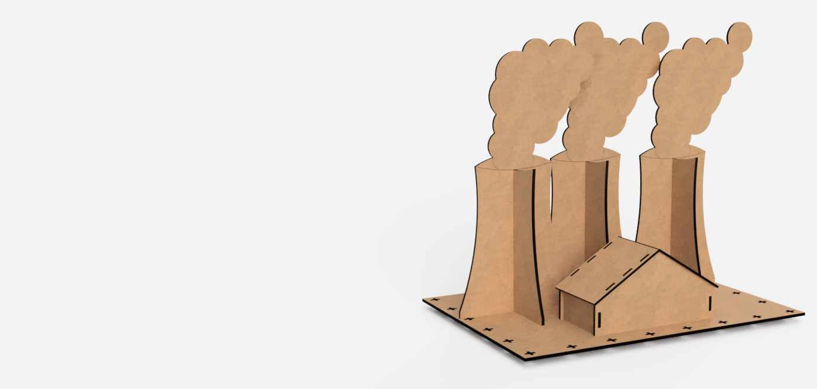
  Interviews and Rotation Activities
Interviews
Notes:
Workbook page 6.
4 Mock interviews to be taken at a time for a 15 minute duration. Additional, rotation activities (next slide) are available for participants who are waiting for their interview or have finished their interview.
*Interview scoring sheets
GFG staff to conduct mock interviews with the participants (qualification 2.1). Staff to rate participants performance out of 10, based on the following aspects:
Dressed appropriately
Preparedness
Knowledge of position
Question answers
Body language and attitude

Slide 45
  Rotation Activities
Presentation
Exhibition Preparation
Notes:
Presentation on next slide

Slide 46
  Exhibition Presentation
Rotation Activity
Notes:
*Laptops/tablets
Teams tasked with using Microsoft PowerPoint to create a presentation to showcase their STEM kit, CV, job they applied for and what they have learned.
Task to be completed by team members who are either waiting for their interview or have completed their interview.
Teams that have completed both, can start preparing for their exhibition.

Slide 47
  2.2: Use feedback to review their performance and state what they would do differently in the future
Notes:
2.2 (Interview Skills): Use feedback to review their performance and state what they would do differently in the future.
Workbook page 6.
Participants are tasked with reflecting on their feedback and considering what they would do differently in the future, considering the following:
Was I prepared enough?
Could I have dressed more appropriately?
Could I believe in myself more and display more confidence?
Qualification: Every interview needs to be filmed for evidence. Interviewer to sign interview statement page in the workbook - page X

Slide 48
Day 4 Recap
Any questions
Skills used: problem solving, team working, perseverance, etc…
Recap: Interview Skills
Well done!

Slide 49
Day 5 Timetable
Day 5
Introduction and finalisation
Exhibition preparation & feedback
Exhibition & celebration
Notes:
Read out the overview for the day.

Slide 50
Week’s Recap
Any questions about any of the information covered by the course?
Who can tell me what digital skills are?
Who can tell me what information a CV should cover?
Who can tell me what skills are important when preparing for and conducting an interview?
Who can tell me what is going to power electric arc furnaces in the steel plants of the future?
Notes:
Run through the questions from the slide

Slide 51
Exhibition Preparation
Present STEM kit
Prepare presentation/display
Display CV
Notes:
Recap the following information regarding the exhibition:
Teams to present their STEM kit
Teams prepare a powerpoint/presentation to display their CVs and to talk about the jobs that they have applied for - Workbook page x
Teams to talk to guests through their STEM kit
How it was retrofitted
Current steel plant vs Future
Sectors and jobs
What participants have learned
Answering any questions
Support provided by staff

Slide 52

Finalisation
Complete any unfinished work
Notes:
*Hand out feedback forms
Ask all participants to complete the feedback form
Participants are given the opportunity to complete any unfitted work before starting preparations for their exhibition.
Also provides an opportunity for staff to double check participant’s qualification answers. Ensuring that all the questions have been answered and that their is sufficient evidence, such as, photos, CV, full sentences, etc…

Slide 53
Exhibition
Notes:
Recap the following information regarding the exhibition:
Teams to present their STEM kit
Teams prepare a powerpoint/presentation to display their CVs and to talk about the jobs that they have applied for - Workbook page 6.
Teams to talk to guests through their STEM kit
How it was retrofitted
Current steel plant vs Future
Sectors and jobs
What participants have learned
Answering any questions
Support provided by staff

Slide 54
Celebration
Notes:
Congratulate participants for their work and endeavour. Present each participant with their certificate.

