Slide 1


R
OMANIA
Notes:
Welcome everybody
Introduce GFG
Staff members introduce themselves
Social Contract = respect between staff and participants, etc
- Ask if participants have any questions before the course begins

Slide 2

Introducere
Notes:
Overview of the course:
Students will learn about blast furnaces and how they are being replaced with modern electric arc furnaces to combat climate change. In pairs students will use STEM (Science, Technology, Engineering and Maths) skills to construct a model blast furnace from wooden and electrical components. Pairs will compete in a game to make all LED lights within the model’s chimney to glow red. The player within each pair who has the fewest attempts will win, but also the pair with the fewest combined attempts will win the overall trophy.
- Place students to work in pairs

Slide 3

Rezultatele programului
Dezvoltarea de abilități comportamentale, precum lucrul în echipă, comunicarea, rezolvarea problemelor, răbdarea etc..
Dezvoltarea abilităților STEM
Cultivarea înțelegerii tehnologiilor verzi din cadrul industriei oțelului în continuă metamorfoză
Pregătirea pentru Programul pentru Elevi al Fundației GFG anul 2 & săptămâna Rewise
Distrați-vă!
Notes:
Click through and read out the 5 course aims from the screen
On point 2 ask learners if they can remember what STEM stands for (science, technology, engineering and maths)
Hand out the workbooks 1/pair

Slide 4

Programul pentru Elevi al Fundației GFG Anul 1
Recapitulare
Cursa cu mașinuțe
Motivație și Conștientizare de mediu (Săptămâna Rewise)
Bomba cu semințe
Notes:
Ask participants what events they remember from last year before clicking them into the slide.

Slide 5
STEM
Ce înseamnă STEM?
  Care credeți că sunt abilitățile STEM?
Ce fel de cariere necesită abilități STEM?
Notes:
Click through the 3 points and ask participants to contribute to the discussion.
1. What does STEM stand for? Science, technology, engineering and maths
2. What STEM skills can you think of? Problem solving, engineering, creativity, communication, coding, etc…
3. What careers require stem skills? Engineers, coders, architects, designers, electricians, mathematicians, health and safety, etc…

Slide 6
Motivația
Ce este motivația?
  Ce v-a motivat pe voi să vă schimbați?
Vă simțiți motivați pentru anul 2?
Notes:
Click through the 3 points and ask participants to contribute to the discussion.
1. What is motivation
2. Has what motivates you changed
3. Are you motivated for year 2

Slide 7
Bombele cu semințe
Plimbare de observație
Notes:
Ask participants what they remember from their seed bomb event.
Partake in an observational walk to see the progress of the seed bombs they planted.

Slide 8

Felicitări!
Certificate de calificare
Notes:
Thank and congratulate all participants on their efforts on passing the qualification.
Hand out their certificates.
Next slide contains interviews from Nathan, Zuzanna and Oliver introducing themselves and welcoming participants to year 2.

Slide 9

Notes:
Play video.

Slide 10


Social Media
Urmăriți-ne pe:
Instagram: @gfg_foundation-romania @libertysteel_galati
Facebook: GFG Foundation Romania
  Folosiți hashtags: #
Notes:
Ask students to follow the social media accounts on the slide. Tag them into any photos they upload to social media and include the hashtags.

Slide 11
Furnal vs cuptor cu arc electric
Notes:
Ask students what they know about blast furnaces and if they have heard about electric arc furnaces.
Staff are encouraged to input additional information and their own knowledge on blast and electric arc furnaces.

Slide 12

Definiții
Furnal
Cuptor cu arc electric (EAF)
Notes:
Ask participants if they can define blast furnace and electric blast furnace
Definitions are on the next 2 slides

Slide 13
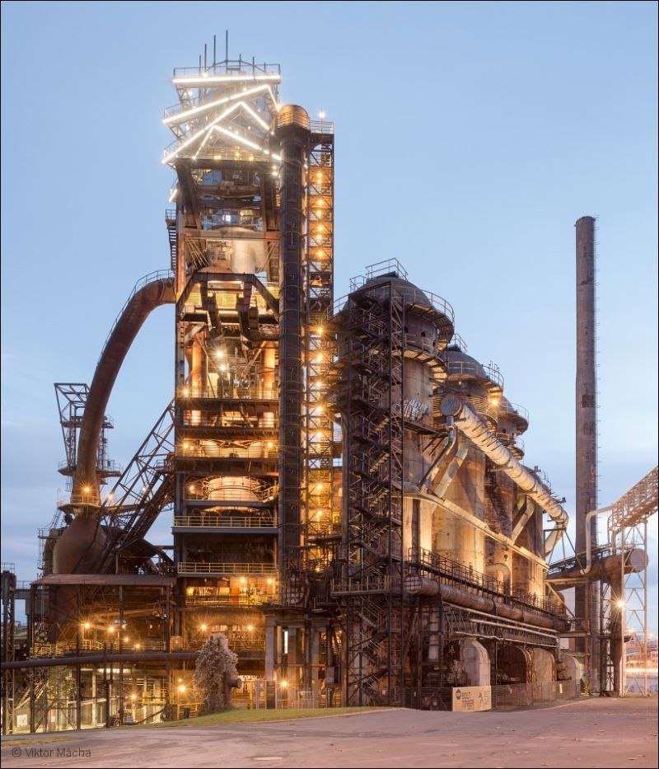
Definiții
Furnal
Un cuptor în formă de turn în care se introduce aer comprimat cald. Astfel de cuptoare se folosesc în principal la obținerea fontei dintr-un amestec de minereu de fier, cocs și var.
Notes:
Ask participants if they can define furnace, blast furnace and electric blast furnace
Click to introduce the definitions onto the screen
Tell learners that to pay attention to the video on the next slide as it provides help to answer the upcoming card game.

Slide 14
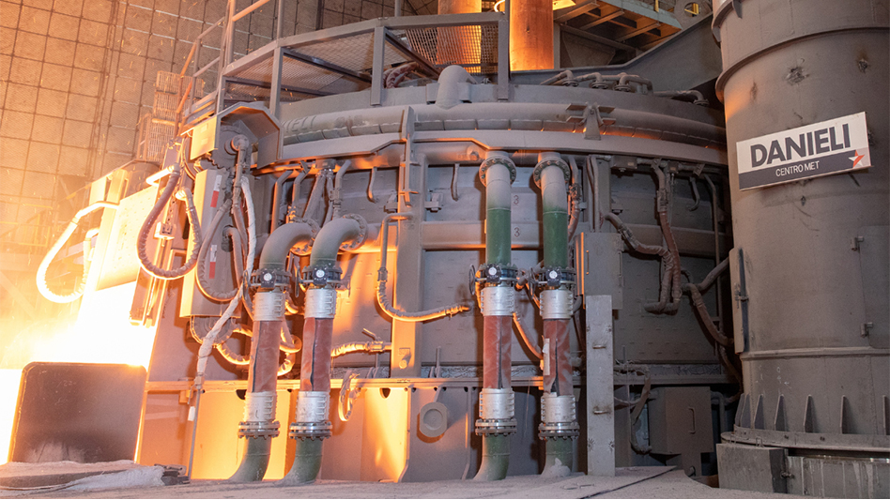
Definiții
Cuptor cu arc electric
(EAF)
Un cuptor care folosește arcul electric ca sursă de căldură, în special pentru a face oțel. Acesta mai poate fi acționat cu ajutorul surselor de energie regenerabilă, precum parcurile eoliene sau solare.
Notes:
Ask participants if they can define furnace, blast furnace and electric blast furnace
Click to introduce the definitions onto the screen
Tell learners that to pay attention to the video on the next slide as it provides help to answer the upcoming card game.

Slide 15
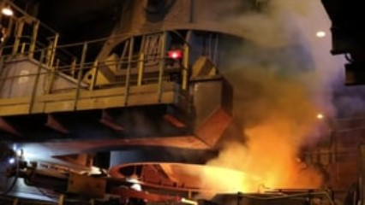
Notes:
Play the video

Slide 16
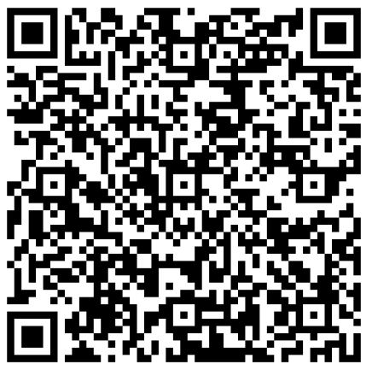
Notes:
QR code to the digital version of the GFG Blast Furnace workbook.

Slide 17
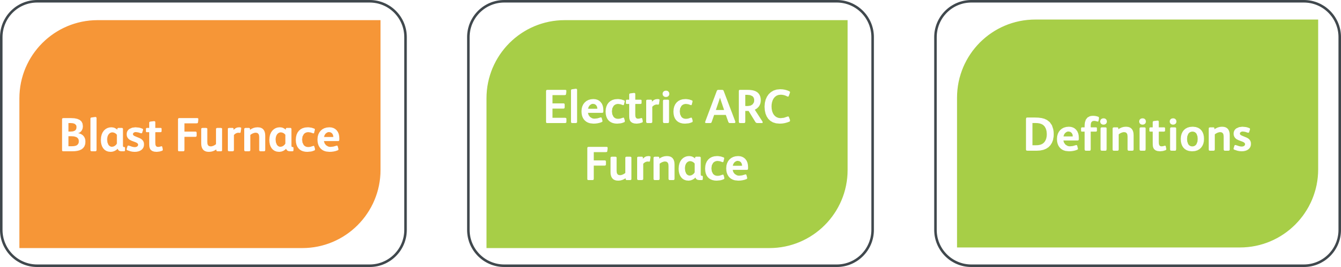
Furnal
Jocul cu cartonașe
Cuptor cu arc alectrci
Furnal
Definiții
Notes:
Handout blast furnace card game cards - 1/pair
Workbook page 2
Each pair to receive a set of the blast furnace card game cards. The three topic cards are “Blast Furnace”, “Electric ARC Furnace” and “Definitions”. Learners, in their pairs, must read through all of the cards and assign them under each card’s related topic card.

Slide 18

Activități de familiarizare
Notes:
The aim of the familiarisation activities is to give learners time to organise their kit’s components and learn about them before they start building.
Hand out the wire instructions

Slide 19
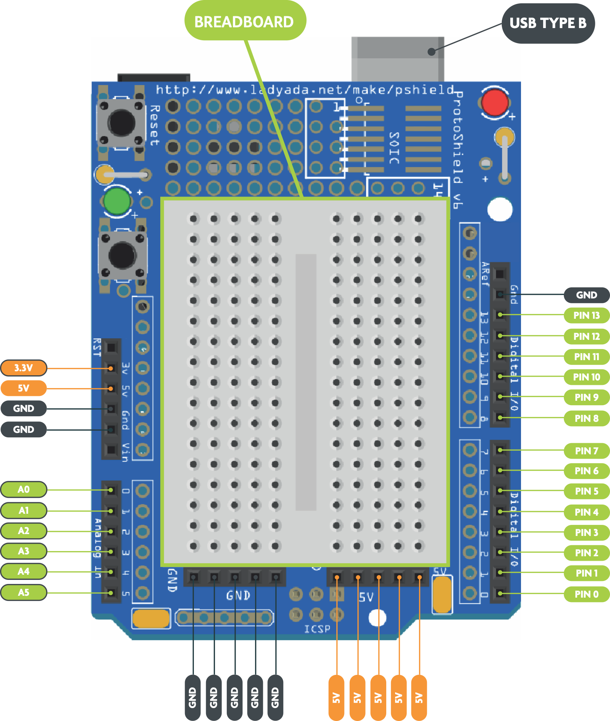
Notes:
Ask learners to turn to page 3 of their workbook
Explain the labelled elements of the motherboard listed below
Talk learners through the different pins used on the motherboard before asking them to match the correct descriptions to the correct pins in their workbook (page 4)
Descriptions and Answers to the matching activity
GND: Pins that provide a negative charge, can also be labelled as - or G.
3.3V: Pins used to output (give) 3.3 volts of power.
5V: Pins used to output (give) 5 volts of power.
Breadboard: Pins that can be used as an extension cable.
Pin 0 - Pin 13: Digital pins that can be programmed to do a certain job.
A0 - A5: Analogue pins that can be programmed to do a certain job.
Learners complete this activity within their workbook - Page 4

Slide 20
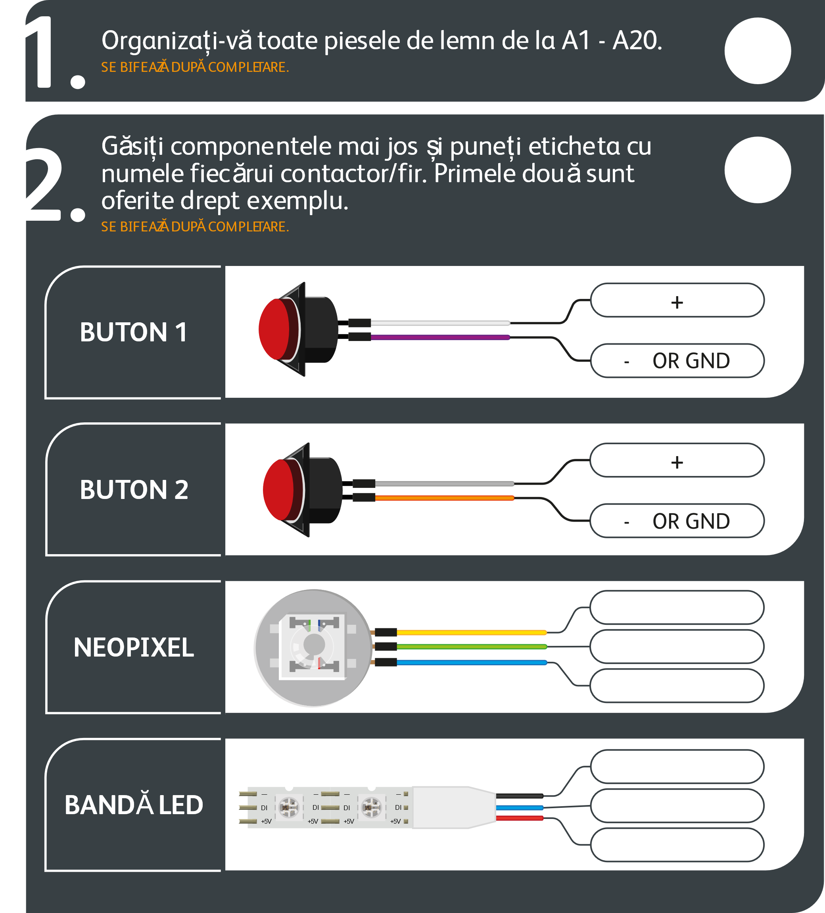
Organizarea și etichetarea componentelor
Notes:
Ask learners to turn to page 5 of their workbooks
Learners to open their blast furnace kits and follow their workbook activities to organise and label their components - Page 5
Learners organise their wooden pieces in order of part number “A1, A2, A3, A4, etc…). Tick once completed.
Labels are found on the component itself
Learners label the pins on the button, neopixel and LED strip. Tick once completed.
Answers
Buttons: White cable = - or GND. Purple cable = + (example completed)
Neopixel: Yellow cable = 5V , green cable = DIN and light blue cable = GND (from top to bottom)
LED Strip: Black cable = GND, dark blue cable = DIN and red cable = 5V (from top to bottom)

Slide 21
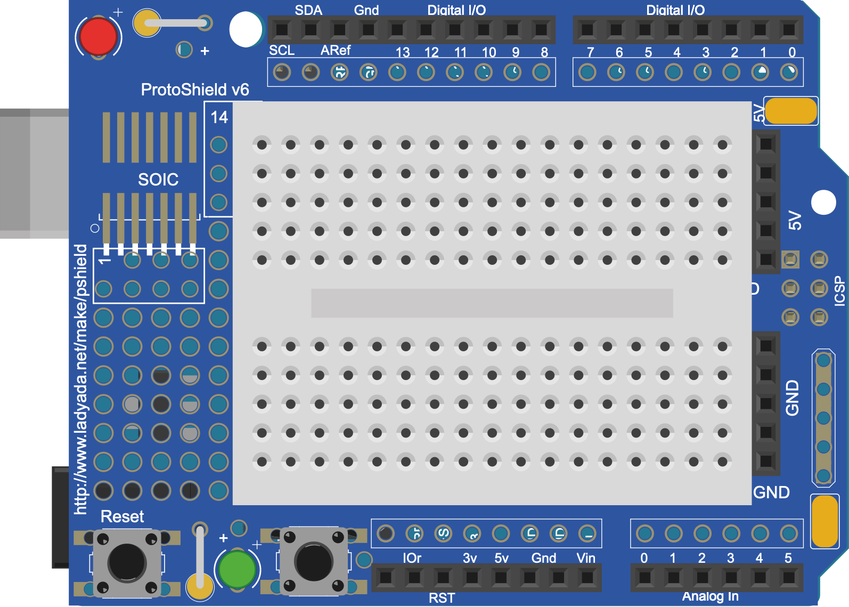
Furnal Circuit
Notes:
Hand out circuit instructions - 1/pair
Explain to learners that the circuit will be built and tested separately to the model initially before being dismantled and built again within the model itself. This is to ensure that learners can work the circuit before the model becomes involved, which will make it more difficult to diagnose and troubleshoot any issues.
Have a prebuilt circuit ready as an example and reference.

Slide 22
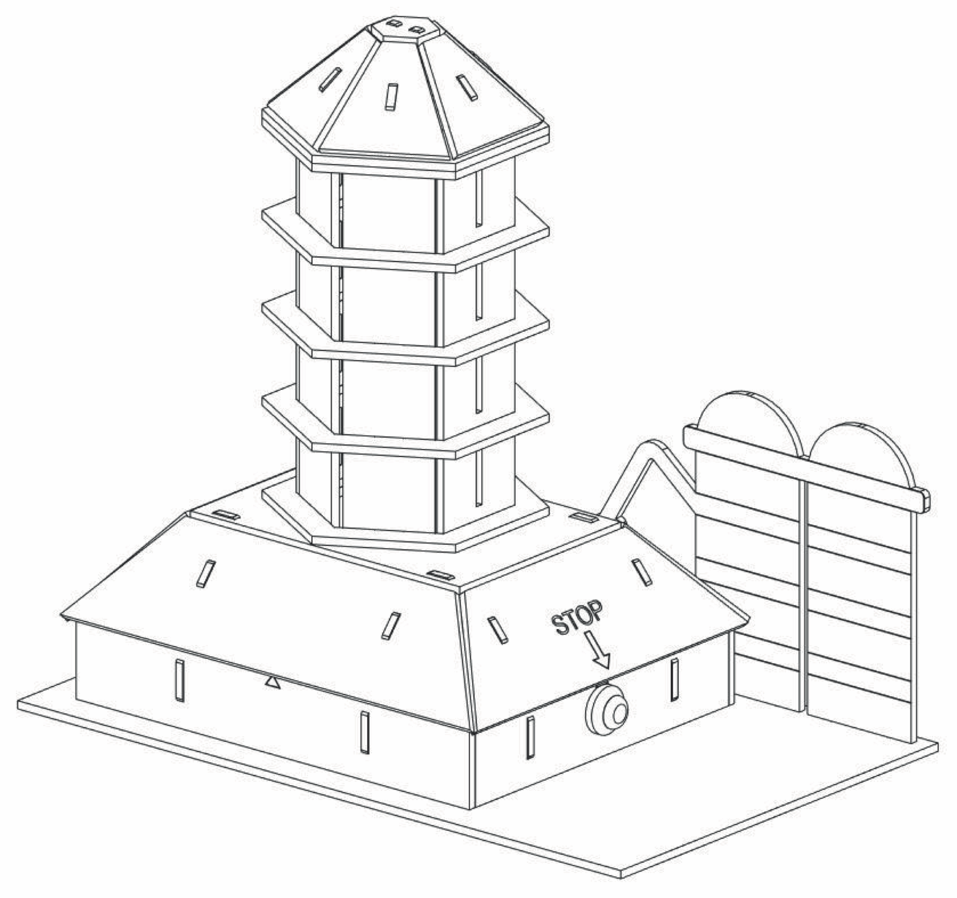
Construirea furnalului
Notes:
Handout blast furnace instructions - 1/pair
Once the circuit is completed and is fully working pairs must disconnect all circuit connections before using the blast furnace instructions to build their models.
Have a rebuilt furnace as an example and reference.

Slide 23

Jocul Furnalul
Notes:
Handout scorecards - 1/pair
Participants takes turns in pressing and holding the button on their model blast furnace. Holding the button activates the lights within the chimney. The lights loop from yellow through orange and red before starting again at yellow.
The aim of the game is for the participant to release the button when all the lights are red. Their teammate logs their number of attempts on the scoresheet. Teammates take turns to play and score. Like a penalty shootout in football, each teammate plays 5 times with the person achieving all red lights in fewer attempts in each round scoring the point. After each round, press the other button to increase the level of difficulty. The level is indicated by the colour of the light on the base of the furnace.
Level 1 = Red Level 2 = Yellow Level 3 = Green Level 4 = Blue Level 5 = Purple
The player within each pair who has the fewest attempts will win, but also the pair with the fewest combined attempts will win the overall trophy.

Slide 24
Rezumat
Abilități utilizate:
STEM
Răbdare
Lucru în echipă
Comunicare
Rezolvarea problemelor
Notes:
Click and read through the skills that the participants have used.
Hand out certificates

Slide 25
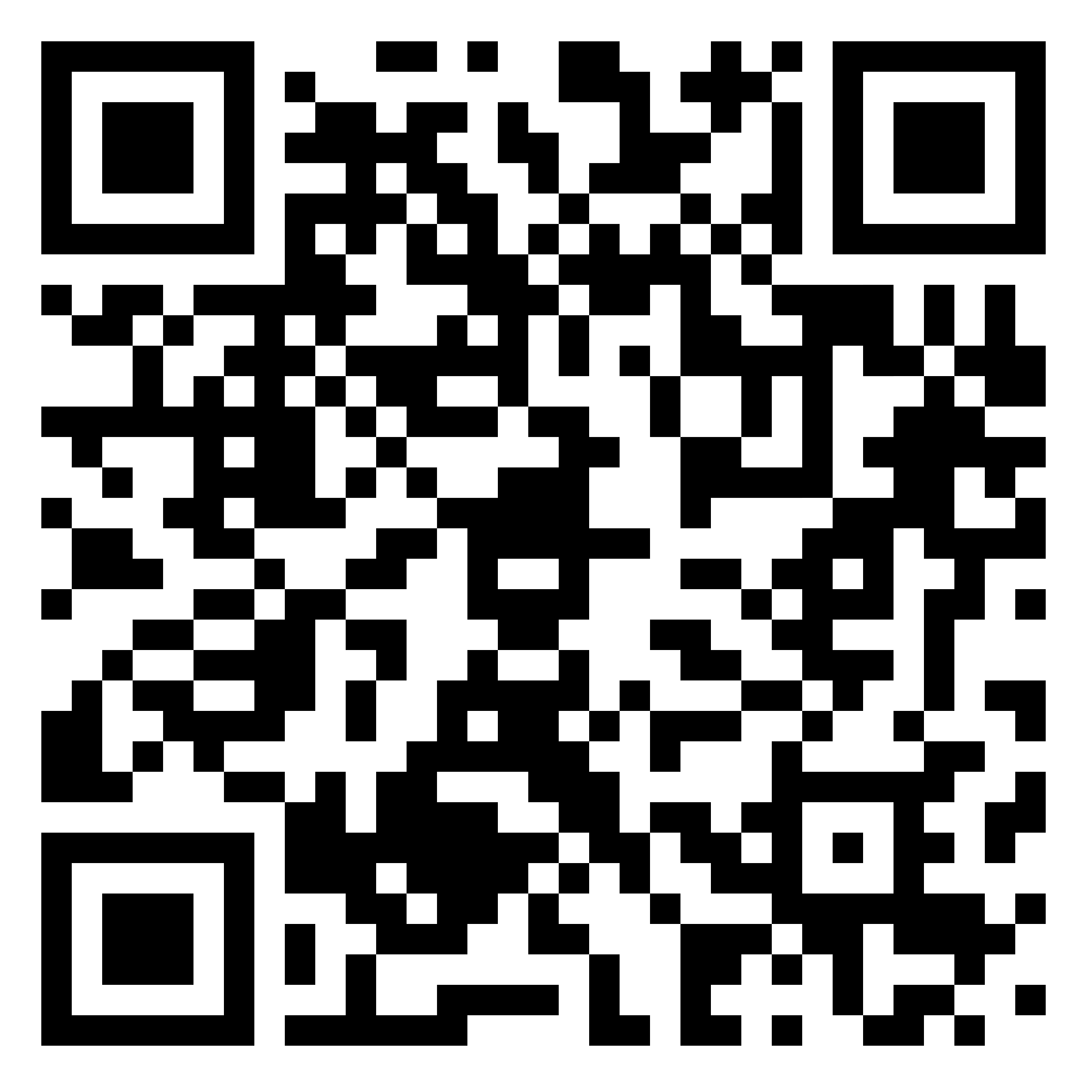
Notes:
QR for students to scan and fill out feedback form about the workshop.

Slide 26
Felicitări!
Mulțumesc !
Notes:
Thank and congratulate all participants on their efforts.

