Slide 1


R
OMANIA
Notes:
Welcome everybody
Introduce GFG
Social Contract = respect between staff and participants, etc
- Ask if participants have any questions before the course begins

Slide 2

Notes:
Overview of the course:
In this workshop you will gain knowledge of biodiversity and the importance of maintaining garden areas through creating seed ‘bombs’ that will supplement the GFG Liberty Club’s green spaces. You will have to consider the different habitats in the area and best match the seeds/plants to them. The course will ficus on teamwork and planning so that you are prepared to plant your seed bombs.

Slide 3
Course Aims
Develop knowledge and practise of environmental awareness
To understand the importance of biodiversity
To execute an action plan to create seed bombs to plant at the GFG Liberty Club
Notes:
Read out the 3 course aims from the screen

Slide 4


Ice Breaker
Name
Interesting Fact
What do you remember about Environmental Awareness?
Notes:
Tell participants that before the course starts it would be good for everybody to get to know each other better
Staff also participate in activity first to put the young people at ease
Participants only to join in if they are comfortable to do so – initially this should be done in the groups of 5 that they will be in all week.
Tell participants that an interesting fact can be a hobby, somewhere they have been, someone they have met, pets, etc. It might be something that they do all the time, but to us it is interesting

Slide 5
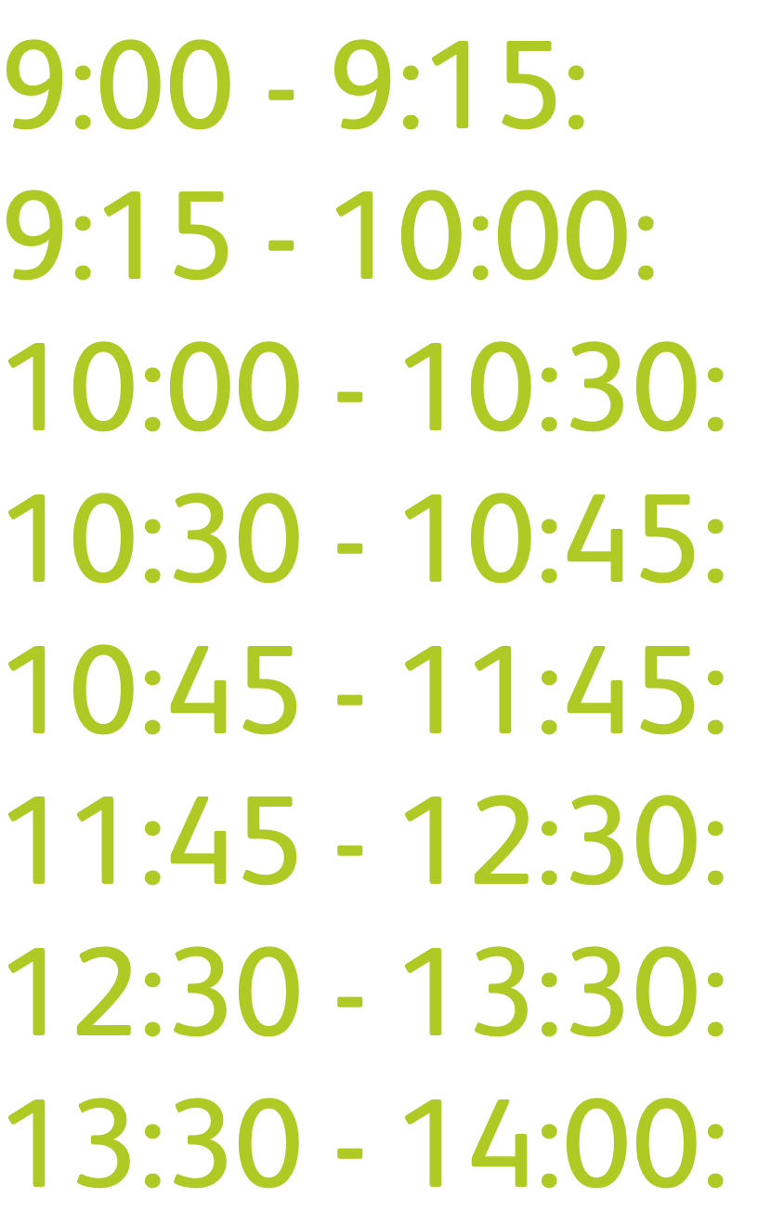
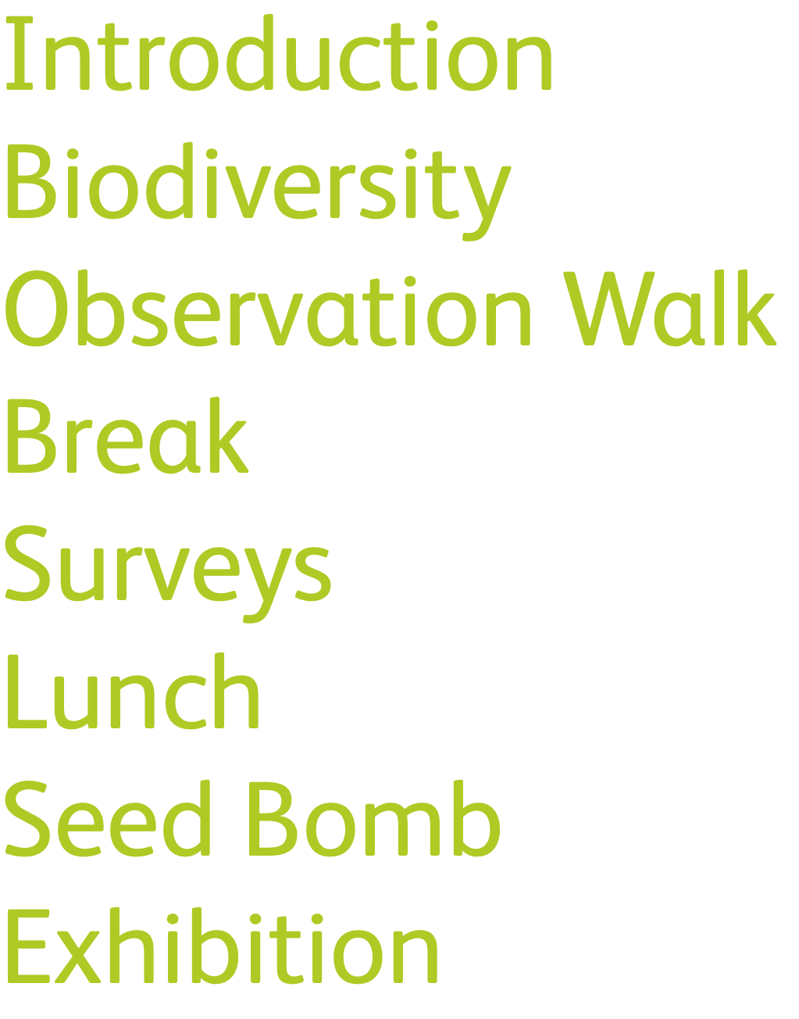
Day Timetable
Notes:
Overview and breakdown of how day 1 will run
Timetable is to be used as a guide for the day and timings may differ
HAND OUT BOOKLETS AT THIS POINT

Slide 6
BIODIVERSITY
Notes:
Ask participants if they know what biodiversity is
Definition is on the next slide

Slide 7
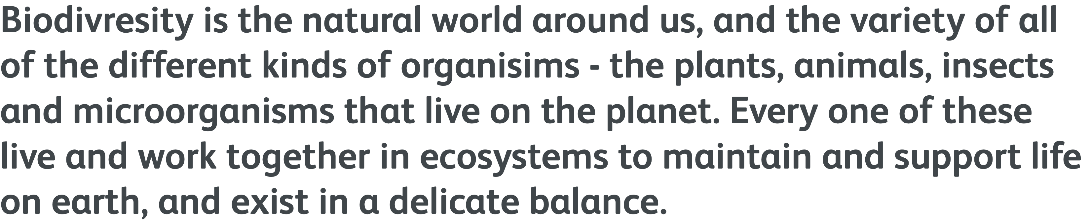
Biodiversity
Notes:
- Read out the biodiversity

Slide 8
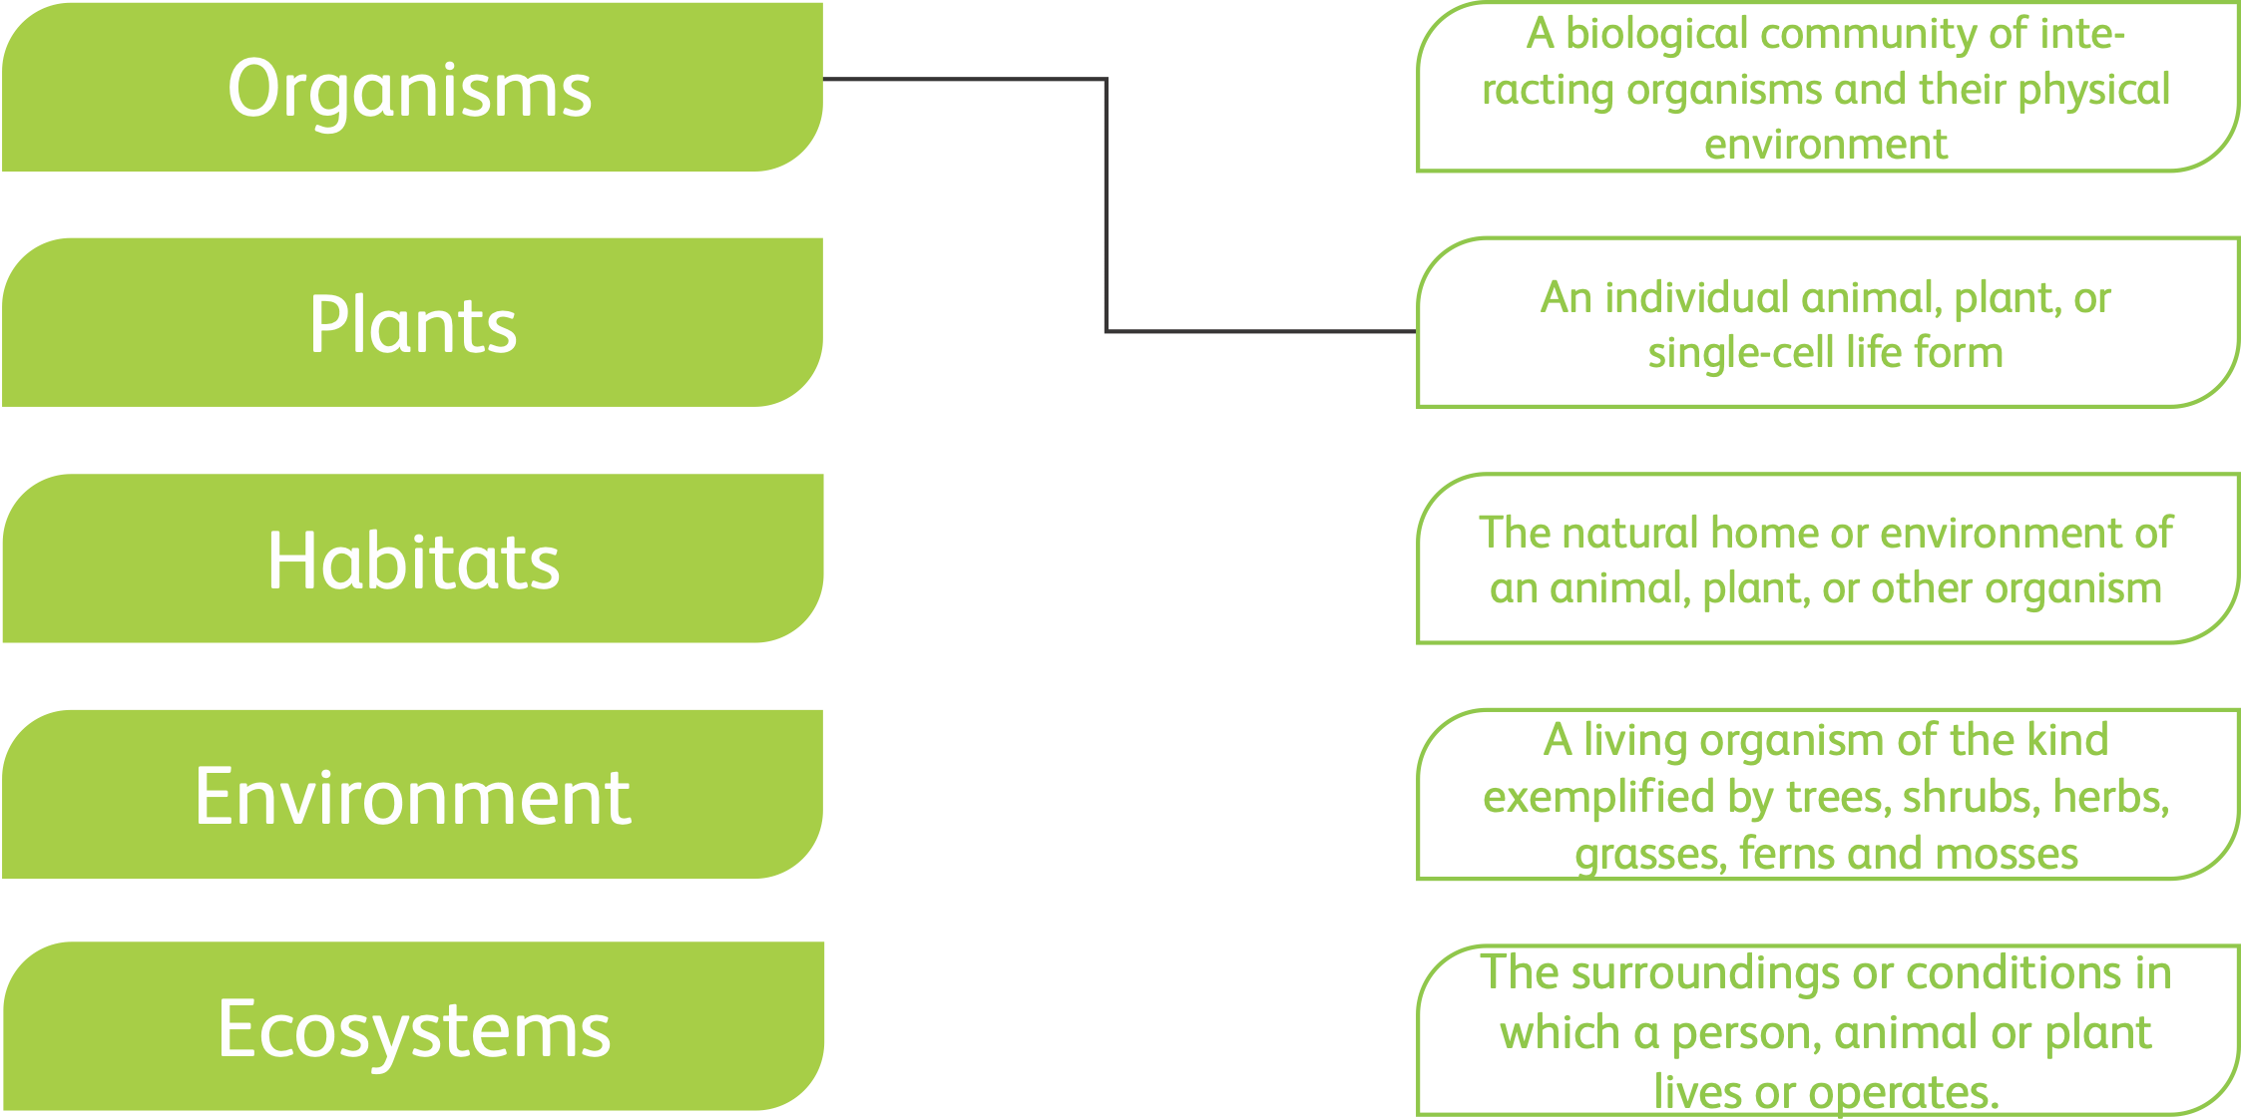
Matching Activity
Notes:
Ask participants to complete the first activity within the workbook
Answers
Organisms - done as an example
Plants - a living organism of the kind exemplified by trees, shrubs, herbs, etc…
Habitats - The natural home, etc…
Environment - The surroundings or conditions, etc…
Ecosystem - a biological community of interacting organisms, etc…

Slide 9

Habitats
Romania’s habitat consists of 27.59% forests, 17.24% grasslands, 12.64%, coastal and salt-tolerant, 11.49% freshwater and 9.2% bogs.
Notes:
- Ask learners if they have heard of any of the types of habitats lists with the booklet on the “habitats” page
- read out the information on Romania’s habitats from the slide

Slide 10
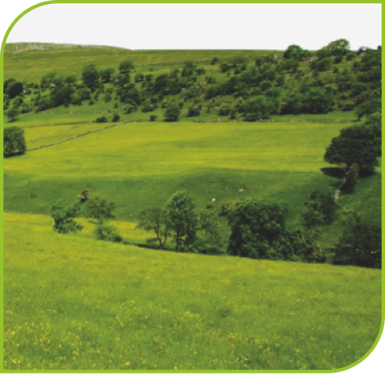
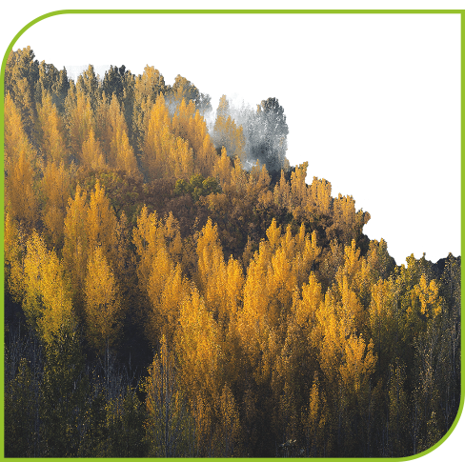
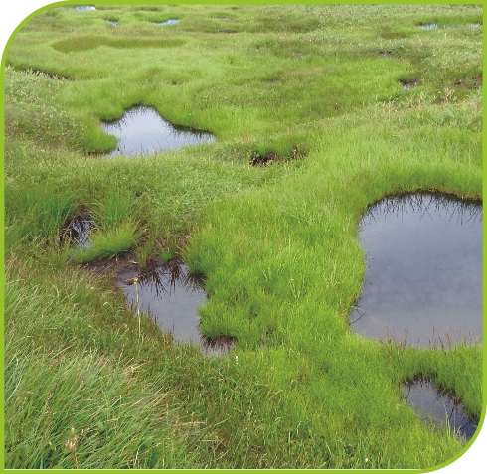
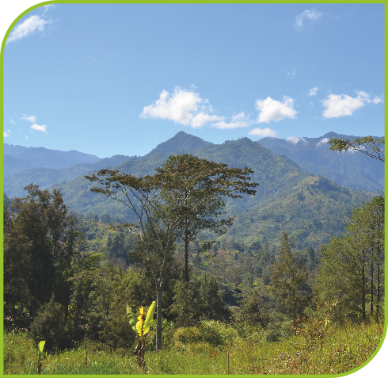

Habitats
Notes:
Ask different learners to read out the definitions for each of the 5 habitat examples found in Romania.
From left to right: grassland, forest, bog, mountain and coast

Slide 11

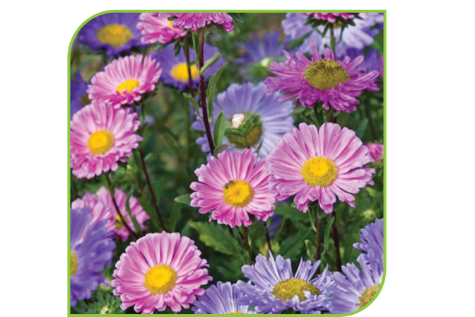

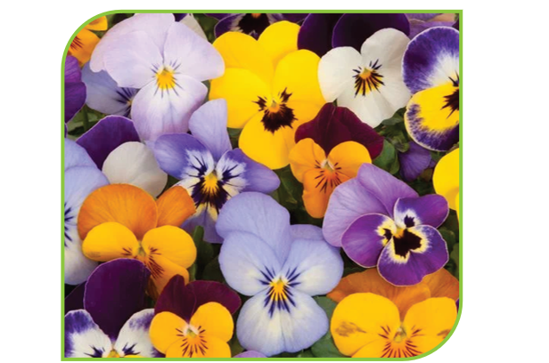
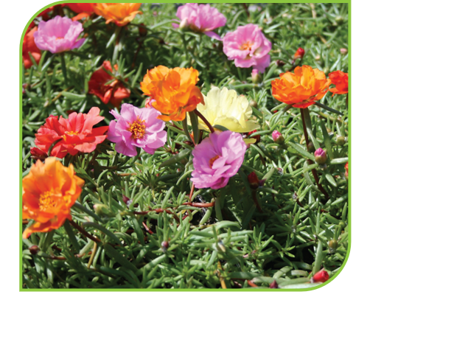
Seeds
Notes:
Ask different learners to read out the descriptions of each plant
From left to right: crocus, red clover, lady’s bedstraw, common spotted-orchid, wild thyme
The descriptions should help the learners to look out for what habitats would suit these plants in the Liberty Club’s green spaces

Slide 12
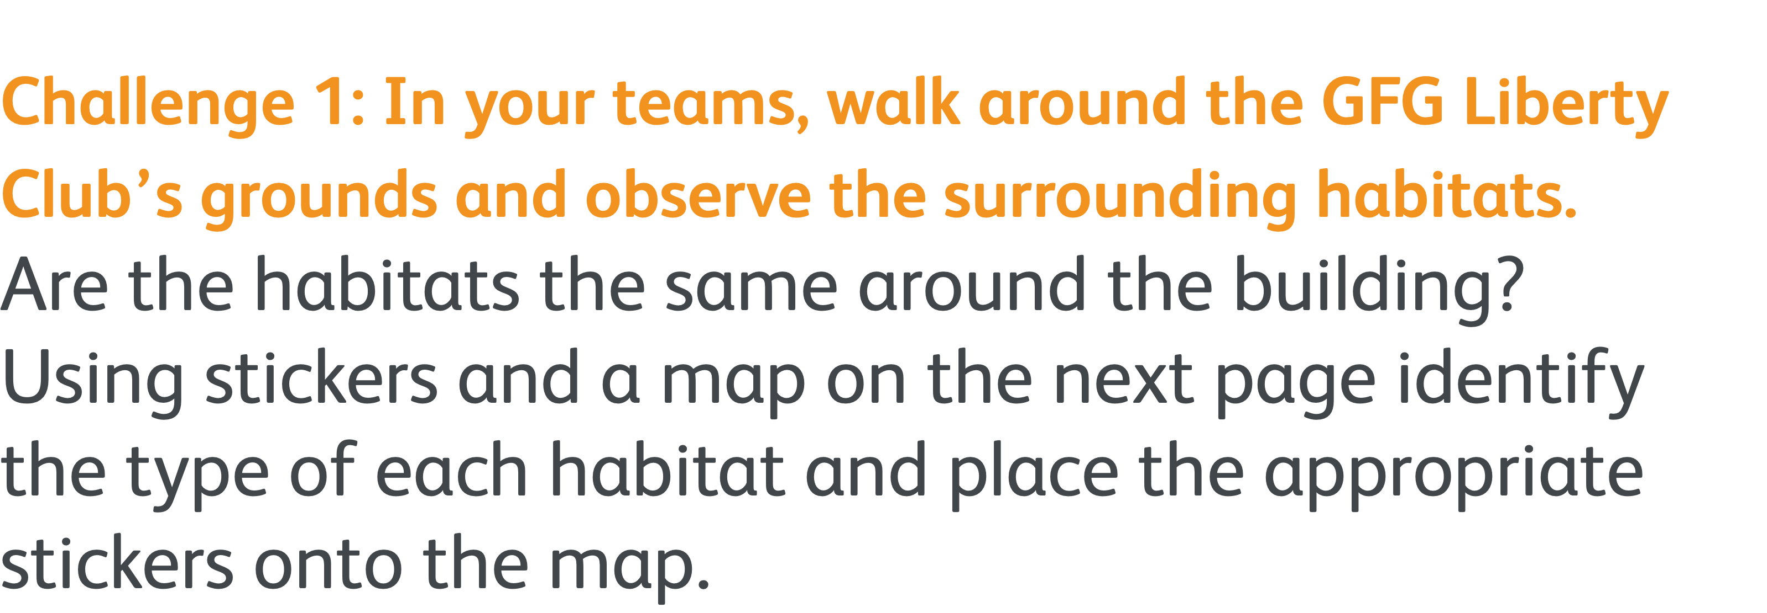
Observation Walk
Notes:
Learners take their booklets on the walk and can make notes on the ‘notes’ page at the back.

Slide 13
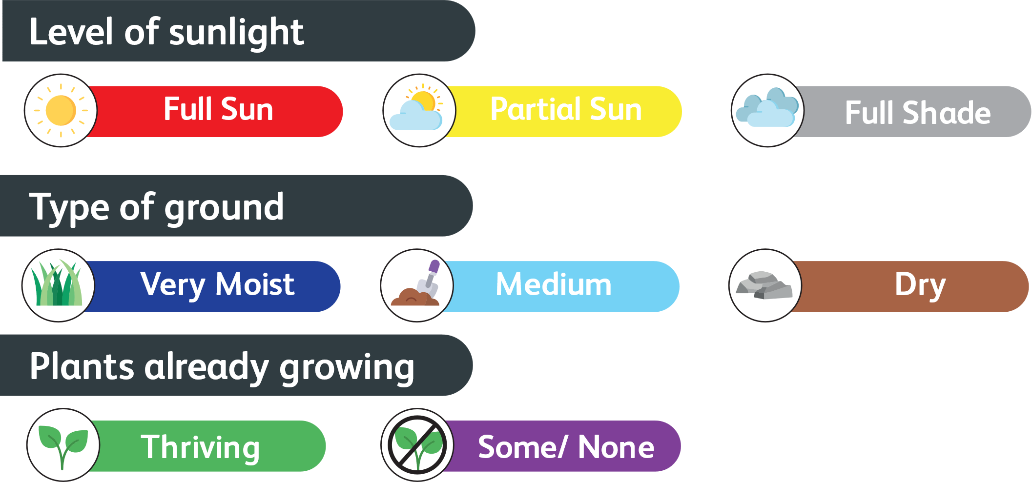
Observation Walk
Notes:
Learners use the stickers on the map in the booklet to indicate the habitats that they find.

Slide 14

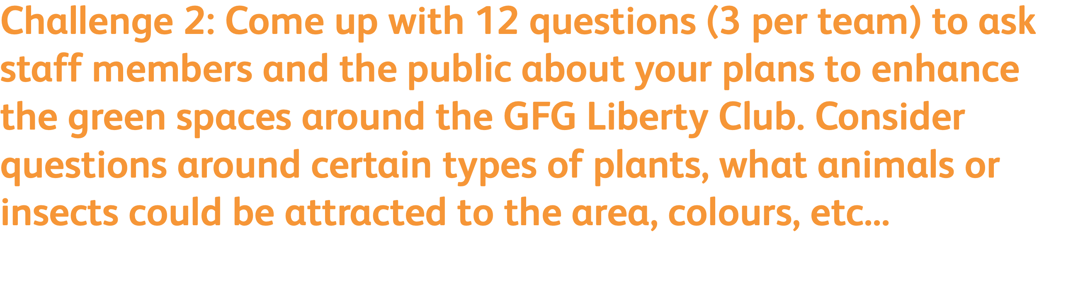
Survey
r

Slide 15
Survey
r
Notes:
Ask learners to ask staff, their peers and members of the public (near the Liberty Club) their survey questions and write them out in their booklets on page 8.

Slide 16
SEED BOMB
Notes:
HAND OUT SEED BOMB KITS
Learners use page 10 in their workbook for instructions to create their seed bombs.
Learners decide on what combination of seeds to use based on the habitats available to them around the Liberty Club

Slide 17
The Exhibition
Notes:
Learners, within their teams, show case their work to visitors to the exhibition, including a walk around the Club to show where they have planted, what seeds they choose and why they choose them.
- Learners could also show visitors how to create their own seed bombs.

Slide 18

Congratulations!
Thank you!
Notes:
Thank and congratulate all participants on their efforts throughout the week
- Provide a re-cap if their is time

